Slide 1
Kenton A. Fong, Senior Financial Analyst Key Insights & Recommendations Portfolio Project: New Saas (Software-as-a-Service) Tech Solutions Inc.
Purpose- Project created to identify key business insights and recommendations for a hypothetical Saas (Software-as-a-service) technology company that can be presented to either the Sales, Marketing, and/or Product teams. Analysis contains several recommendations to generate over $6 million in additional revenue from either cross-selling or upselling of various products.
Resources- SQL, Tableau visualization software, Excel, Microsoft Word and PowerPoint.
Methodology- 1) Identified key Saas financial data that is relevant to Sales and Marketing Teams, 2) designed initial layout and content of a sales database in Excel, 3) performed preliminary financial analysis, 4) uploaded data into SQL to obtain additional insights, 5) drafted key insights and recommendations, and 6) loaded data into Tableau to create various dashboard charts and graphs.
Date- February 27th, 2025
1

Slide 2
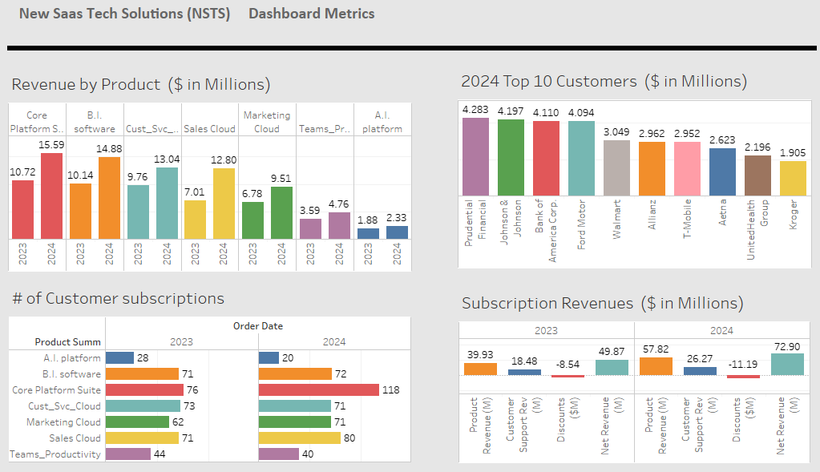
NSTS (New Saas Tech Solutions)- Dashboard Metrics
2

Slide 3
NSTS (New Saas Tech Solutions)- Key Insights
Business Profile and Financial Highlights for the year 2024:
NSTS serves 155 major corporate customers across the globe.
The top five customers in 2024 were: Prudential Services, Johnson & Johnson, Bank of America, Ford Motor Co., and Wal-Mart.
NSTS ended the year 2024 with a record $72.9 million in net subscription revenue, a 46% increase over the previous year.
Key Insights:
NSTS provides seven major product solutions and two service subscription levels (Standard and Premium): The products include: Artificial Intelligence platform, Business Intelligence software, Core Platform Suite, Customer Service Cloud, Marketing Cloud, Sales Cloud, and Teams Productivity.
NSTS offers three different customer support plans: Standard (level 1), Premier (level 2), and Signature (level 3).
In 2024, the Core Platform Suite generated the largest source of net subscription revenue at $15.6 million (or 21% of total company revenue). Business Intelligence software came in second place with $14.9 million (or 20%) of total company revenue.
Continued on next page….
3

Slide 4
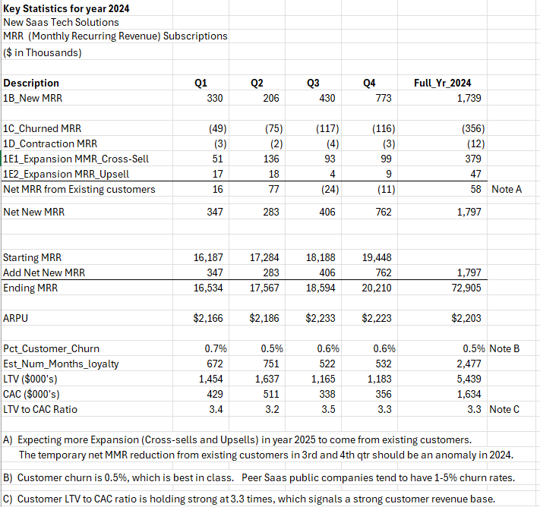



NSTS- Key Insights (Review of 2024 Subscription revenue, Churn, and other stats)
Key Findings:
Note A: An anomaly appears in the 3rd and 4th quarter whereby the net MRR (Monthly Recurring Revenues) had temporary decreases. These net decreases are expected to disappear in 2025 as part of more expansions (Cross-Sells and Upsells).
.
Note B: Customer churn rate for 2024 was 0.5%, which is best in industry. Similarly sized Saas public companies tend to have 1-5% churn rates.
Note C: The ratio of Customer LTV (Lifetime Value) to CAC (Customer Acquisition Costs) is holding strong at 3.3 times, which signals a strong customer revenue base.
4

Slide 5
NSTS (New Saas Tech Solutions)- Key Insights, continued
A detailed analysis of 2024 subscription revenue transactions revealed several revenue growth opportunities for the year 2025.
Opportunity # 1: Four specific products have the potential to generate additional revenue in the year 2025.
31 customers could benefit from the A.I. platform and may lead to $1.1 million in incremental revenue in 2025.
25 customers could benefit from the Teams Productivity platform and may lead to $1.6 million in additional revenue in 2025.
22 customers could benefit from the Sales Cloud platform and may lead to $1.8 million in additional revenue in 2025.
16 customers could benefit from the Marketing Cloud platform and may lead to $1.3 million in additional revenue in 2025.
Opportunity # 2: Some customers could benefit by upgrading their customer support level from Standard to Premier. The majority of NSTS customers have a subscription to a Premium (level 2) product but only have a Standard (Level 1) customer support plan.
If customers upgrade their customer support plan from Standard to Premier (Level 2), incremental customer support revenue in between the range of $391 thousand and $783 thousand could be realized in 2025
If customers upgrade their customer support plan from Standard to Signature (Level 3), then somewhere between $861 thousand and $1.7 million in additional revenue could be generated in 2025.
Continued on next page….
5

Slide 6
NSTS (New Saas Tech Solutions)- Recommendations
Below recommendations should be considered for year 2025, as follows:
For opportunity # 1, the Sales and Marketing Team should review the detailed report of customers. If a successful campaign to cross-sell these products to the current customer base is launched, these product cross-sells could lead to $5.8 million in incremental revenue in 2025.
For opportunity # 2, the Sales and Marketing Team should review the list of customers who have a Premium level subscription product but only have a Standard (Level 1) customer support plan. If these customers elect to upgrade their support plan levels, an estimated range between $391 thousand (conservative estimate) and $1.7 million (aggressive estimate) in additional revenue could be achieved in 2025.
6

Slide 7
NSTS (New Saas Tech) - SQL Database Overview & Analysis Steps
Overview:
Purpose: Create reporting and analysis for a major Saas (Software as a Service) technology company.
Key Business Partners: Finance, Sales, Marketing, and Product teams.
Major Data Analysis Process Steps:
Review business & industry: Studied major Saas products on SalesForce CRM website; searched for industry average
gross margins for Saas companies.
Identify key business metrics: Sales by Product, Customer Support Plan levels, Top 10 Customers & Industries.
Create sample dataset: Retail sales data obtained from Kaggle website. Added missing data columns tied to metrics.
Perform Data Cleaning: Designed data tables, identified primary keys and data types, clean and standardize data.
Upload data into database: Imported the .csv load files into each database table.
Build SQL queries: Used Primary Key fields to join each table. Summarized financial data by years.
Design Tableau dashboards
Draft Insights & Recommendations
Upload to GitHub website: Drafted commentary for ReadMe sections; obtained https: internet hyper-links.
7

Slide 8
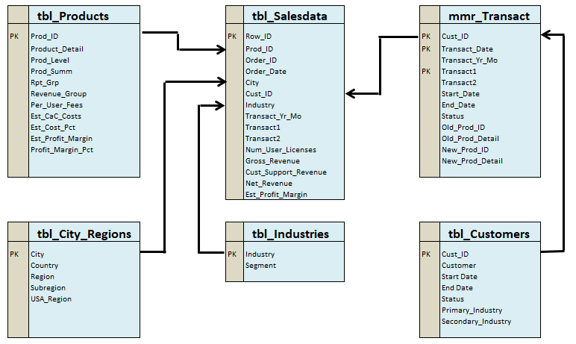
NSTS- SQL Database Design Overview (Table relationships)
8

